Slide 1

Software Architecture
SSE USTC Qing Ding
dingqing@ustc.edu.cn
http://staff.ustc.edu.cn/~dingqing

Slide 2

Service Oriented Architecture

Slide 3
outline
Directions of System Architecture
Overview of SOA
History of SOA
What is a Service Oriented Architecture?
SOA Concepts
Service-Oriented Architecture
SOSE

Slide 4
Directions of System Architecture
1960 - 1980
1990 - 2000
2010 - 2050
Organization Focus
Mainframe Centric
Internal Use
Unique Data
Process Focus
Client Server
Partial Connectivity
EDI File Transfer
Distributed Functions
Data Centric
Universal Interoperability
Real-time Connectivity

Slide 5
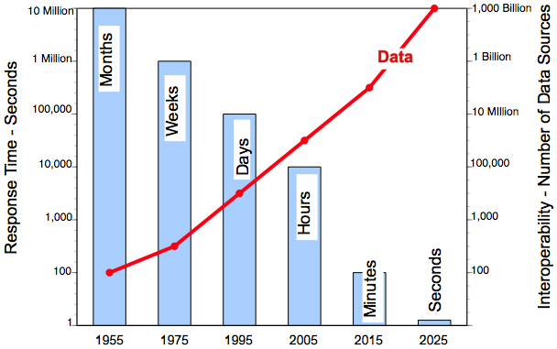
Data Interoperability Expands as Response Time Shrinks

Slide 6
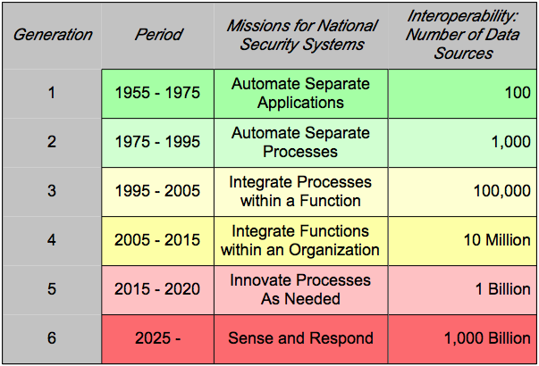
Interoperability Does not Scale

Slide 7
Why SOA? – The Cruel Reality
Application
Screen
Scrape
Message
Download
Application
Application
Queue
File
Application
Screen
Scrape
Sockets
Transaction
Screen
Transaction
File
Scrape
File
Application
Download
CICS Gateway
Sockets
RPC
File
APPC
ORB
Application
ORB
Message
Application
Application
Message
Transaction
Queue
Application
File
Message
CICS Gateway
Queue
Transaction
Screen
File
Scrape
Application
Message
Download
APPC
RPC
File
Source: Gartner

Slide 8
Why SOA?
Respond to business changes
Address new needs with existing applications
Unlock existing application investments
Support new channels & complex interactions
Support organic business
Oracle
Financials
Custom Order
Application
New Web
Application
Standard Interface
Standard Interface
Standard Interface
New Supply Chain Management Application
(Business Process or Composite Application)
Standard Interface
Standard Interface
Standard Interface
Siebel
CRM
Mainframe HR
Application
.NET Inventory
Application

Slide 9
Overview of SOA

Slide 10
Service-Oriented Architecture (SOA) is an architectural style that represents business functionality as implementation-neutral, standards-based shared services
SOA is a natural progression in the evolution that accelerated with the advent of XML and Web Services
SOA enables enterprises to be more agile and to respond more quickly to changing business needs
Some characteristics of SOA are:
  Use of shared services — do not need to “reinvent the wheel”
  Loose coupling — can update applications with minimal effect on services that invoke them
  Location transparency — can re-host applications with minimal effect on services that invoke them
  Based on open standards — decreased dependence on vendor-specific solutions
This means enhanced interoperability for government agencies

Slide 11
SOA enables an enterprise to avoid costly integration scenarios that utilize point-to-point connections between applications
Traditional “point-to-point” approaches to building IT environments have lead to a “spaghetti” approach to integration..
With SOA, applications are exposed as services that can be integrated through a unified service bus
App
Service
Service
Service
App
App
SERVICE BUS
App
App
Service
Service
With this approach, when business processes or requirements change, agencies must undertake costly upgrade projects and introduce new connections
This approach enables services to be “swapped in and out” or updated with minimal effect on existing services
SOA services are not necessarily Web Services, though in many cases they will be

Slide 12
SOA supports Business Process Management (BPM) by exposing shared services that can be shared across multiple processes
BPM Executable
BPM Executable
BPM Executable
BPM Executable
BPM Executable
BPM executables implementing business processes access various information services to perform activities and manage workflow
Human
Resources
Grants
Management
Customer
Service
Budgeting and
Forecasting
Acquisition
Service
Service
A robust SOA provides the framework to define reusable services to support a wide range of business processes
Service
Service
Service
Open standards enable leveraging of information assets from many agencies by “hiding” complexities of underlying agency infrastructures
Server
Server
Server
Server
Data
Server
Server
Data
The result: A high degree of flexibility and agility for government operations

Slide 13
History of SOA

Slide 14
SOA has a rich history
1970s
1980s
1990s
Early 2000s
TODAY
Object-Oriented Programming
Electronic Data Interchange (EDI)
Distributed Object Computing (CORBA/DCOM/DCE)
Client/Server Computing
N-Tier Architectures (J2EE)
Enterprise Application Integration (EAI)
XML
Web Services
Service-Oriented Architectures (SOAs)
These can be considered precursors to today’s Service-Oriented Architectures
SOA as a concept has been done for quite some time – but now, we are leveraging the power of the World Wide Web

Slide 15
Then and Now: A Brief Comparison Between CORBA and SOA

Slide 16
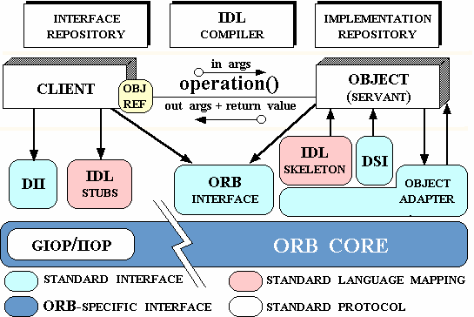
Common Object Request Broker Architecture (CORBA) is an open, vendor-independent architecture and infrastructure that computer applications use to work together over networks
It was created by the Object Management Group (OMG)
Interface for client/ORB communication
Provides infrastructure by which objects communicate
Facilitates ORB-to-ORB communication
Source: http://www.cs.wustl.edu/~schmidt/corba-overview.html

Slide 17
CORBA has many complexities that are mitigated by SOA
Factor | CORBA | SOA
“Weight” of implementation | Heavyweight | More lightweight
Degree of coupling | Tight coupling (to components) | Loose coupling (between services and their underlying applications)
Communication Mode | Synchronous only | Synchronous or asynchronous
Initial investment | Large | Small-medium (depending on requirements)
Protocol type | Binary | Text
Processing “grain” | Fine-grained processing | Coarse-grained or fine-grained processing (depending on requirements)
Proprietary Level | Proprietary implementations | Non-proprietary implementations
It is important to note that services within an SOA can have CORBA components “behind” them

Slide 18
Relation between Enterprise Architecture (EA) and SOA

Slide 19
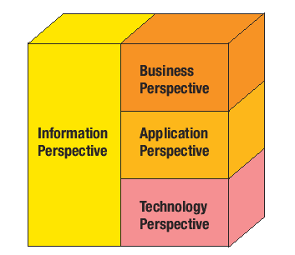
An Enterprise Architecture is a critical ingredient in an organization’s technology planning and overall operation
An enterprise architecture normally takes the form of a comprehensive set of cohesive models that describe an enterprise’s structure and functions
It normally reflects different “views” or “perspectives” that relate to various areas of an enterprise’s overall operations
Includes broad business strategies
Describes the information required to properly manage processes, operations, and infrastructure
Defines the enterprise’s application portfolio
Describes the hardware and software that supports the organization
Source: “Dissecting Service-Oriented Architectures”, Lublinksy and Tyomkin, Business Integration Journal, October 2003

Slide 20
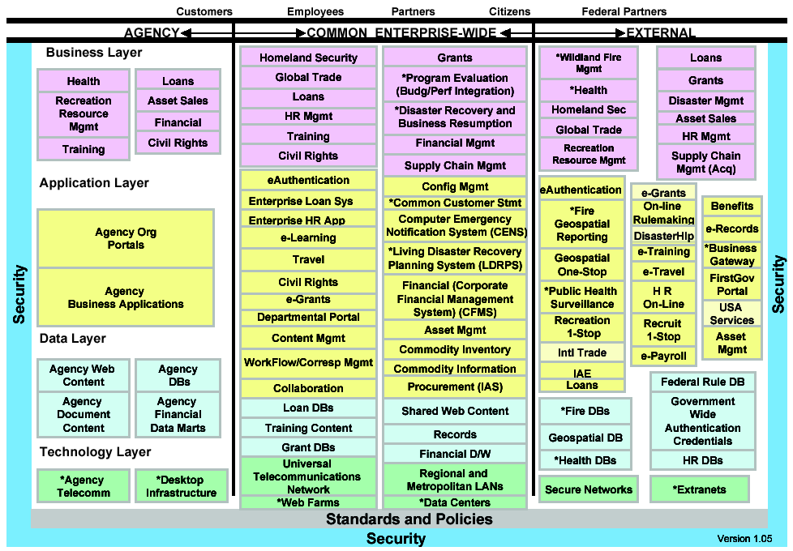
An Enterprise Architecture provides a foundation by which a Service-Oriented Architecture can clearly emerge
The following is a real-world example from a US federal agency’s Enterprise Architecture
Functions in Agency tier are Service Consumer “candidates”
Functions in External tier are Service Producer “candidates”
Functions in Common Enterprise-Wide tier are both Service Producer and Consumer “candidates”

Slide 21
What is a Service Oriented Architecture (SOA)?
A method of design, deployment, and management of both applications and the software infrastructure where:
  All software is organized into business services that are network accessible and executable.
  Service interfaces are based on public standards for interoperability.

Slide 22
Key Characteristics of SOA
Quality of service, security and performance are specified.
Software infrastructure is responsible for managing.
Services are cataloged and discoverable.
Data are cataloged and discoverable.
Protocols use only industry standards.

Slide 23
SOA Concepts
Notes:
(Trends, SOA Concepts, Ref Arch, Technologies, Standards, Practices, Use Cases,..)
2005Jun27 Goal= high-level estimation of consulting costs, any infrastructure costs, software licenses, etc.
Planning/designing an SOA architecture and will require
WBISF or equivalent, since we have found uses for BPEL within our current and new processes.
-=-=
Future Content for Systems Assurance Review & Readiness Plan
"core business systems“, "strategic assets“ (as opposed to “Legacy”)
multi-year investment in these computing systems
We likely want help our customers "leverage, extend and integrate"
(as opposed to "modernize" these strategic assets).

Slide 24
Becoming an On Demand Business
An On Demand Business is an enterprise whose business processes — integrated end-to-end across the company and with key partners,
suppliers and customers — can respond with speed to any customer demand, market opportunity or external threat.
Integrate
people, processes, and information
Align
business models and strategic objectives
Technology Infrastructure
Business and IT processes
Optimize
application infrastructure
Business
Design
Extend
your reach
Notes:
IBM has defined an On Demand Business as an enterprise whose business processes – integrated end-to-end across the company and with key partners, suppliers and customers – can respond with speed to any customer demand, market opportunity or external threat.
Achieving the goal of becoming On Demand requires a dual focus. It requires a focus on Business Design – looking at the business models and business processes themselves, and modifying them to focus on the core competencies of the business and to eliminate any inefficiencies inherent in the business model itself. Optimizing business models is an important step in becoming an On Demand business, but it’s not enough. The underlying technology infrastructure must be capable of instantiating the new business processes, and it must also be capable of quickly adapting to any future changes in business processes. Companies can start by addressing their business design, or they can start by addressing their technology infrastructure. Regardless of where they start, both areas must be addressed in order to become On Demand. Let’s look at the issues involved in both areas of focus toward becoming On Demand.
In looking at their business design, companies seeking to become On Demand Businesses must insure that their business models are aligned with their strategic objectives. In many companies today, operations are disjointed, with internal departments operating as functional “silos”, hoarding information and operating independently of one another. As a result, redundant processes can proliferate. These functional silos can also reduce the flexibility of the organization in adapting their business processes to address changing market demands. In an ideal environment, companies would be able to model their existing business processes as well as any new business processes, examine those processes to determine where bottlenecks exist, modify the processes to achieve optimum efficiency, deploy the modified processes, and monitor them to insure that they’re operating as planned.
Aligning your business models with your strategic objectives is important, but not sufficient in and of itself. Your underlying IT infrastructure must be capable of instantiating those business processes. Breaking down functional silos from a business process perspective requires an IT environment that enables people, processes, and information to be integrated in a flexible manner. Increasing efficiency requires an IT infrastructure environment that is optimized to support a high-level of business flexibility and can scale to meet increased demand with minimal impact on capital expenditures. Finally, the underlying IT infrastructure must allow companies to extend their business reach to new customers and partners, through new business models and new ways of interacting. Because existing applications often can’t be ripped out and replaced, it also requires that those applications and the information they control be accessible by the new business processes.

Slide 25
Four Characteristics of On Demand
Integration
  Providing the linkage between people, processes, and data
Open
  Supporting a strong commitment to standards for OS, Language and Web Services/SOA
Virtualized
  Providing a flexible Build-time and Runtime environment for developing and running applications across a highly distributed IT architecture
Autonomic
  Self regulating … self healing … self maintaining
Notes:
There are four key focuses to On-Demand:
Integration – Providing the linkage between people, processes, and data
Open – Supporting a strong commitment to standards for OS, Language and Web Services/SOA
Virtualized – Providing a flexible Buildtime and Runtime environment for developing and running applications across a highly distributed IT architecture
Autonomic – Self regulating … self healing … self maintaining

Slide 26



SOA: Service Oriented Architecture
An approach for building distributed systems that allows tight correlation between the business model and the IT implementation.
Characteristics:
  Represents business function as a service
  Shifts focus to application assembly rather than implementation details
  Allows individual software assets to become building blocks that can be reused in developing composite applications representing business processes
  Leverages open standards to represent software assets
Notes:
SOA represents a focused approach towards implementing/developing component oriented solutions – it comes directly from the mandate of MDA/MDD – by representing discrete functions as services and promoting application assembly (versus “development from scratch”), it enables a “building block” approach which encourages the reuse of assets to solve problems as well as enabling the ability to choreograph services to create higher level coarse services. Most importantly, it is founded on open standards to promote interoperable solution design and delivery.

Slide 27
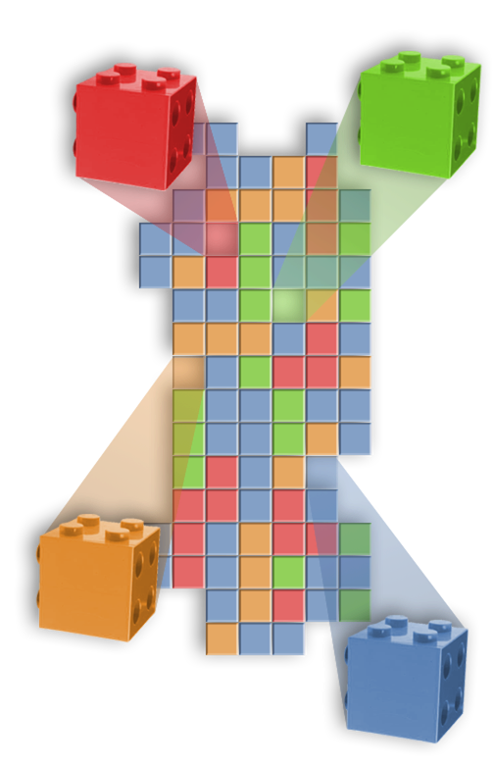
SOA Definitions
What is a service?
A repeatable business task – e.g., check customer credit; open new account
What is service orientation?
A way of integrating your business as linked services
and the outcomes that they bring
What is service oriented architecture (SOA)?
The IT architectural style that supports
service orientation
What does SOA mean to business?
Business flexibility
Improved customer service
Lower costs and greater revenue
Notes:
It is appropriate to take some time to understand and define what SOA is all about.

Slide 28
SOA Concepts
What is a service?
  A coarse grained, self-contained entity that performs a distinct business function
What is a service description?
  A standards based interface definition that is independent of the underlying implementation
What is service discovery?
  Use of a service registry to access service interface descriptions at buildtime or runtime
How do services interact?
  Through loosely-coupled, intermediated connections
What is service choreography?
  Control of the execution sequence of services in ways that implement business processes
How are SOA solutions created and enhanced?
  Using tools and middleware according to SOA principles
Notes:
These concepts really form the underlying context for SOA – of all of them, service discovery is still in an evolutionary phase although many initiatives around UDDI and other service repository initiatives will provide more context in this area in the near term. Today – service description is largely WSDL-based – service interaction is over an ESB/”smart” messaging framework to enable delivery as well as routing/transform/mediation – service choreography via BPEL – and service creation via MDA/MDD and tools approaches akin to the WebSphere Studio family for application assembly, process choreography, software development management and component definition/discovery.

Slide 29
Flexible & Adaptable business models & supporting IT architectures
…are required today for business survival
Flexible Business Models
Transformation, Business Process Outsourcing,
Mergers, Acquisitions & Divestitures
Composable
Processes
(CBM) Component
Business Modeling
Requires
Enables
Flexible IT Architecture
Software Development
Integration
Infrastructure
Management
Composable
Services
(SOA)
Service Oriented Architecture (SOA)
Development
Infrastructure
Management
On Demand Operating Environment
Notes:
SOA enables Flexible BI Solutions - Increased financial pressures require greater flexibility from business models and supporting IT architecture

Slide 30
Three Key Concepts for the Foundation for On Demand
Build –Model Driven Architecture
  A style of enterprise application development and integration based on using automated tools to build system independent models and transform them into efficient implementations1
Run –Service Oriented Architecture
  An approach for designing and implementing distributed systems that allows a tight correlation between the business model and the IT implementation
Manage –Business Performance Management
  An approach to systems management that tightly links IT concerns with business process concerns
¹ Source: Booch, et al, “An MDA Manifesto”, published in the MDA Journal, May 2004
Notes:
From an IT perspective – moving to the world on On-Demand from an integration perspective comes down to three key focus areas –
MDA – To provide a solution framework that maps directly to the business processes and provide abstraction services to build platform independent implementations that can be used to implement integration solutions
SOA – To provide a runtime environment that encourages component/service design and construction across distributed environments
BPMS – To monitor both IT as well as Business metrics as part of the operational management of the distributed SOA solution foundation

Slide 31
SOA & Business Process Choreography Services Animation
‘Coarse-Grained’ – Long Running, Interruptible, Compensation Transaction network
Process Container
State
UOW2
Process
UOW1
GUI
Sync
JCA
Async
JMS
Legacy,
Package
Web
Service
External
B2B
ESB
UOW1
UOW2
“Wrapped” Services & Implementations
‘Fine-Grained’ – Short-Running, non-Interruptible, ‘ACID’ XA Transaction
Notes:
Glen Added Slide
ANIMATED

Slide 32
Messaging Fundamentals
A single solution, with multi-platform APIs (JMS and MQI)
  Easy to use message centric interface
  Network independent
  Faster application development
Assured message delivery
  Exactly Once, Transactional
Loosely-coupled applications
  Asynchronous messaging
  Parallelism, Triggering
Scalable & Robust
  Publish\Subscribe or Point to Point
  Clustering, Large Messages
Pervasive
B
A
Notes:
Assured, exactly once delivery
Single API across 35+ platforms
Network integration across various network protocols
Transactional control
Triggering of jobs/programs
Content independence
Single message > 100MB
Asynchronous design (application & platform independent
Parallel processing
Robust, commercial middleware
Shields developers from network complexities
-=--=-=-=
Benefits
Higher developer productivity by eliminating communication coding
Reliability by providing assured delivery of messages (knowing that your message will arrive at the destination)
Provides business continuity and better customer service because, in the event of infrastructure failure, the messages are retained for processing for when the environment is restored
Network optimization by transmitting a single message into your network and not multiple
Scaleability of large volume-handling applications because transactions(messages) are kept and processed outside of the application (State Street Bank hit a peak of 250 million messages per day)
Flexibility in infrastructure (machines, network protocols, application residences) and higher developer productivity because changes in infrastructure do not affect the application internals
Flexibility in system design by providing an asynchronous paradigm to allow parallel processing
Operational enhancement by changing applications to real-time access due to ability to trigger programs and jobs
Sub-second response time since MQ is a resource manager and handles the majority of requests and objects in memory
Transactional processing capability since it has the ability to commit or rollback messages
Ease of use with minimal number of verbs and tools to allow central administration of the MQ environment
Higher developer flexibility because MQSeries is database-independent and content independent
More developer flexibility and productivity with ability to access the same API through multiple languages
De-facto standard in messaging allows flexibility in software package purchases

Slide 33

Message Broker -Transforms messages ‘in flight’
Delivers messages to the right place and in the right format.
  Examine the content of a message
  Transform the content
  Augment the message
  Warehouses the message
  …and assure Transactional delivery!.
Message Broker
Original Message
Transform message
Reformatted
/ Reshaped
Message
Transform
Q2
Transformation
Node
Appl.
B
Appl.
A
Augment
Augment message
Output
Nodes
Input
Node
+
Augmented
Message
Q1
Appl.
C
Warehouse
Database Node
Q3
Content accessed
from database
WarehouseNode
Database Content
Warehoused
Message

Slide 34
Business Modeling and Monitoring Solution
Process Requirements
Process Modeling
and Analysis
Existing Components
Services
Interaction
Glue
Deploy
Participate
Business Process
Management Infrastructure
Optimize
Manage Execution
Monitor
Analysis
Notes:
Business Performance & Process Management Solutions
WebSphere MQ Workflow automates and tracks complete business processes in accordance with business design, increasing a company's agility while leveraging its IT and organizational infrastructures. It facilitates rapid process deployment with rich support for human interaction.

Slide 35
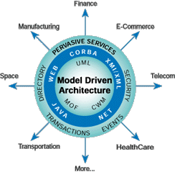
MDA: Model Driven Architecture
Key Concept:
An integration of best practices in Modeling, Middleware, Metadata and Software Architecture
Based on standard Models, Metadata Models, and Model Transformations
Model Driven:
(UML, MOF, CWM…)
Platform Independent Business Models (PIM)
Platform Specific Models (PSM)
Mappings : PIM <==> PSM, PSM<==> PSM (Relative term!)
Metadata Driven:
(MOF, XSD, XMI)
Key Benefits:
Improved Productivity for Architects, Designers, Developers and Administrators
Lower cost of Application Development and Management
Enhanced Portability and Interoperability
Business Models and Technologies evolve at own pace on platform(s) of choice
www.omg.org/mda
Notes:
MDA is the link to creating robust services-oriented designs – it represents the convergence of UML as a modeling discipline with best practices of software development to create a rich and extensible environment for both component/system design and architecture and makes extensive use of prevalent market standards.
Abbreviations:
MOF =Meta Object Facility
XSD = XML Schema Definition
XMI = XML Metadata Interchange
CWM = Common Warehouse Metamodel
EMF = Eclipse Modeling Framework
PIM = Platform Independent Business Model
PSM = Platform Specific Model

Slide 36



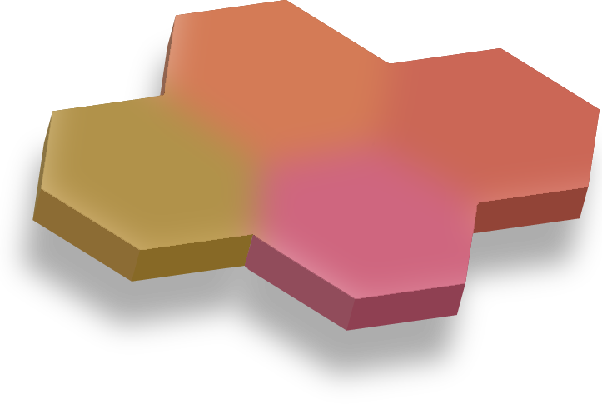

What are the core elements that SOA brings together?
Coming together under
Service Oriented Architecture
Skills - assistance, and best practices
Applications
Industry know-how and best practices linked to business
Flexible, robust infrastructure that reuses existing IT assets
Notes:
**Main Point: SOA brings together key elements of your business including your infrastructure, best practices, applications and skills
What are some core elements that SOA brings together?
Starting at the bottom, you start with a flexible, robust infrastructure. It’s essential to keep in mind that this is NOT a replacement for your existing infrastructure or other existing investments. The SOA infrastructure is more of an overlay to your existing IT assets. This helps you leverage your existing systems in ways you couldn’t do before.
Next comes access to the right know-how and best practices that are linked to the business. This helps users implement SOA in their specific industry and situation as quickly as possible with lower risk and lower cost.
On top of that, the applications that you have installed in your business that perform the functions you use. These are the commercial off-the-shelf applications as well as the home-grown custom applications that carry out the day-to-day IT tasks in your company.
And at the top, to build these skills takes the right, assistance and best practices. Availability of the right skills is one of the most significant considerations we see people facing today.

Slide 37
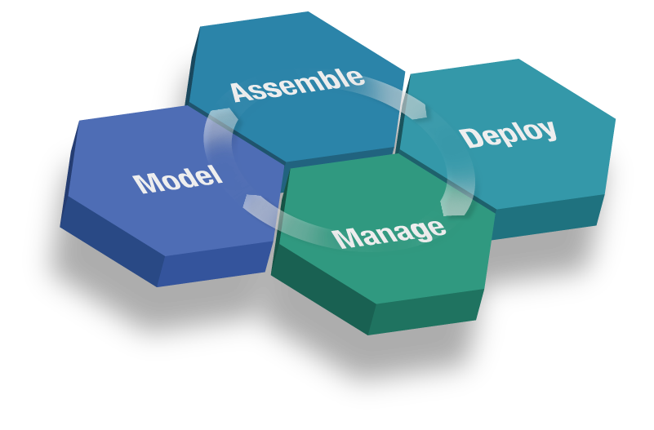
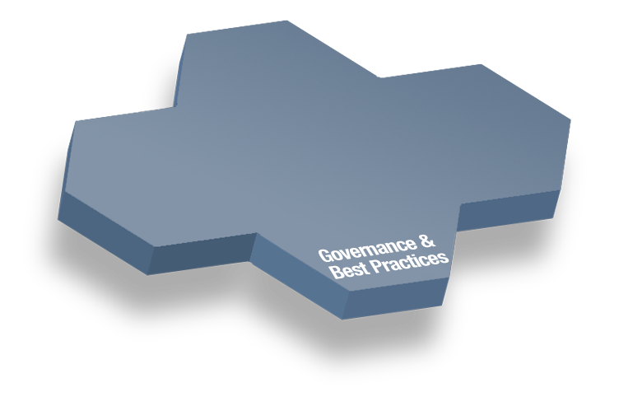
The SOA Lifecycle .. For Flexible Business & IT
Discover
Construct & Test
Compose
Integrate people
Integrate processes
Manage and integrate information
Gather requirements
Model & Simulate
Design
Manage applications & services
Manage identity & compliance
Monitor business metrics
Financial transparency
Business/IT alignment
Process control
Notes:
*Main point: SOA is best considered in terms of a lifecycle. Think of this lifecycle comprehensively and approach it tactically focusing on the sections that provide the most value for you.
Our customers have told us that they take a lifecycle approach to SOA.
Our customers have told us that they think about SOA in terms of a lifecycle. They start in the Model phase by gathering business requirements and designing their business processes. Once they have optimized the business processes, they implement it by combining new and existing services. The assets are then deployed into a secure and integrated environment for integrating people, processes and information. Once deployed, customers manage and monitor from both an IT and a business perspective. Information gathered during the Manage phase is fed back into the lifecycle for continuous process improvement. Underpinning all of these lifecycle stages is governance which provides guidance and oversight for the SOA project.
They start in what we are calling the Model phase by gathering business requirements, designing, simulating, and optimizing their desired business processes. That way, they can make sure they are setting the right steps in motion before further action is taken.
Once they have optimized the business processes, they implement it by combining newly created and re-used existing services to form composite applications.
The assets are then deployed into a secure and integrated environment taking advantage of specialized services that provide support for integrating people, processes and information. This level of integration helps ensure that all the key elements of your company are connected and working together.
Once deployed, customers manage and monitor the composite applications and underlying resources from both an IT and a business perspective. Information gathered during the Manage phase is used to gain real-time insight into business processes enabling better business decisions and feeding information back into the lifecycle for continuous process improvement.
Underpinning all of these lifecycle stages is governance which provide guidance and oversight for the SOA project.

Slide 38
Service-oriented architecture (SOA) definition
“A service-oriented architecture is essentially a collection of services. These services communicate with each other. The communication can involve either simple data passing or it could involve two or more services coordinating some activity. Some means of connecting services to each other is needed.”
(http://www.service-architecture.com/web-services/articles/service-oriented_architecture_soa_definition.html)
Many other definitions can be found

Slide 39
Characteristics of SOA
Services have platform independent, self describing interfaces (XML)
Messages are formally defined
Services can be discovered
Services have quality of
service characteristics defined in policies
Services can be provided on any platform
Composable
Interoperable
Re-Usable
SOA
Loosely
Coupled

Slide 40
Anatomy of a Service
New Service
Service Consumer
Wrapped
Legacy
Interface Proxy
Composite
Service
Service
Interface
Service
Implementation

Slide 41
Service Communication
Communicate with messages
No knowledge about partner
Likely heterogeneous
Service
Consumers
Service
Producers

Slide 42
Service Platform
Service Consumers
Service Delivery Bus
Service Rules
& Config
Service Reporting & Mgmt
Change
Control
Service Interfaces and
Service Implementations

Slide 43
Benefits of SOA
Better reuse
  Build new client functionality on top of existing Business Services
Well defined interfaces
  Make changes without affecting clients
Easier to maintain
  Changes/Versions are not all-or-nothing
Better flexibility

Slide 44
Services Communicate With Messages
Providing reliability and security to messages
Sending messages across consumers and producers
Service Orchestration
Service
Consumers
Service
Producers

Slide 45
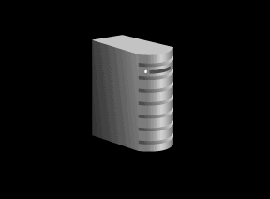
Basic Web Services
UDDI
Registry
Points to
description
WSDL
Points to service
Finds
Service
Describes
Service
Web Service
Client
(J2EE, .NET,
PL/SQL …)
SOAP
Web Service
(J2EE, PL/SQL,
.NET,C/C++,
Legacy …)
Invokes with
XML Messages

Slide 46
Service discovery
Service
registry
lookup
publish
Service
requestor
Service
provider
bind
Notes:
© SE;Service orientation, Hans van Vliet
De meest onderscheidende karakteristiek.
Gegeven een beschrijving van wat je wilt wordt een register geraadpleegd. Daar komt de naam ed van een implementatie van een service uit, en daar bindt je je dan aan.
Aanbieders van services registreren hun services in et register.
Een soort yellow pages uit de telefoongids.

Slide 47
Service discovery
Rental agency 1
Rental agency 2
Rental agency 1
Apartment
(immediate, cheap)
publish
Agency 1
Municipality
system
Apartment?
Rental agency 2
Rental agency 1
Rental agreement

Slide 48
Service discovery
Discovery is dynamic, each invocation may select a different one
Primary criterion in selection: contract
Selection may be based on workload, complexity of the question, etc ⇒ optimize compute resources
If answer fails, or takes too long ⇒ select another service ⇒ more fault-tolerance
Notes:
© SE;Service orientation, Hans van Vliet
Primair criterium: wat biedt de service mij. Bv voice recognition system en ruis verwijderen: snel mar niet zo goed versus goed maar dan wat langzamer.

Slide 49
Is discovery really new?
Many design patterns loosen coupling between classes
Factory pattern: creates object without specifying the exact class of the object.
Notes:
© SE;Service orientation, Hans van Vliet
Factory pattern: definieert een methode om een object te creeren. Een subklasse kan die methode dan overschrijven met een die het type van het object aangeeft.

Slide 50
Services can be composed
Service can be a building block for larger services
Not different from CBSE and other approaches
Notes:
© SE;Service orientation, Hans van Vliet
Niet echt bijzonder qua eigenschap. Maar heb je wel nodig. Bij buitenste lagen zie je vaak dat een service overeenkomt met een business proces, maar lokaler niet zo sterk.
Open vraag is wel of je op alle lagen het service principe moet toepassen. Het levrt potentieel nogal wat overhead op (vele XML messages die uitgewisseld moeten worden, en die nemen nogal wat ruimte in). Zou best dezelfde effecten kunnen krijgen als bij Java beans ed: mooie technologie, gaan we allemaal gebruiken, tot je de performance penalties ziet, en dat gaat men terug naar simpeler technologieen voor de simpele gevallen, en het volledige arsenaal aan toeters en bellen wordt alleen gebruikt daar waar het echt nodig is.

Slide 51
Services adhere to a contract
Request to registry should contain everything needed, not just functionality
For “normal” components, much is implicit:
  Platform characteristics
  Quality information
  Tacit design decisions
Trust promises?
Quality of Services (QoC), levels thereof
Service Level Agreement (SLA)
Notes:
© SE;Service orientation, Hans van Vliet
Platform karakteristieken: tal, OS, versie ! Van tools zoals CoolGen de gebruikt zijn, enzovoort, dbms, etc.
Quality: performance, reliability, etc.
Tacit: bv verschillende componenten van verzekeringsmatschappij gaan er allemaal vanuit dat de ingangsdatum van een polis 1 januari is.
Trust: als component zegt dat hij snel is, of goed getest, geloof je dat dan? Je kunt evidence bij een trusted party leggen, bv de registry. Lijkt op wat je bij COTS componenten wel doet.
Je ziet aan dit vb ook dat je nog best een hoop moet communiceren tussen service provider en service consumer om helder te maken wat je aan informatie wil uitwisselen, en wat dat betekent. In dit geval: immediate en cheap als karakteristieken van een rental agreement. Maar wat betekent precies immediate, en cheap? Mijn ntie van goedkoop kan een heel andere zijn dan de jouwe. Dat moet je dus extern vastleggen!
QoC, SLA: gebruikt om kwaliteitsdeel van contract aan te duiden. Een gegeven dienst kan meer dan 1 QoC level bieden: bv snel en slordig vs langzaam en nauwkeurig.

Slide 52
Service discovery
Rental agency 1
Rental agency 2
Apartment
(immediate, cheap)
Agency 1
Municipality
system
Apartment?
Rental agency 1
Rental agreement
Notes:
© SE;Service orientation, Hans van Vliet
Heen en weer flippen met de vorige slide

Slide 53
Services are loosely coupled
Rental agencies come and go
No assumptions possible
Stronger than CBSE loose coupling
Notes:
© SE;Service orientation, Hans van Vliet
Alles wat ze van elkaar moeten weten, moet via de messages. Bv kun je de ene keer dat je om een goedkoop appertement vraagt de ene agency krijgen, en de volgende keer en andere. Je hebt dus ook loose coupling op het nivo van de business

Slide 54
Services are stateless
Rental agency cannot retain information: it doesn’t know if and when it will be invoked again, and by whom
Notes:
© SE;Service orientation, Hans van Vliet
Lijkt dus een noodzakelijk gevolg van de vorige eigenschap. Service heeft geen variablene die tussen invokaties dingen “onthouden”. Alles gaat expliciet heen en weer in message exchanges. Wat vastgehouden moet worden moet in een database worden opgeslagen.

Slide 55
Services are autonomous, hide their logic
Rental agency has its own rules on how to structure its process
Its logic does not depend on the municipality service it is invoked by
This works two ways: outside doesn’t know the inside, and vice versa
Notes:
© SE;Service orientation, Hans van Vliet
Service weet niet waar de vraag vandaan komt en wat ermee gedaan wordt. En omgekeerd wet aanvrager niet hoe de vraag precies beantword wordt.

Slide 56
Services are reusable
Service models a business process:
  Not very fine grained
  Collecting debt status from one credit company is not a service, checking credit status is
Deciding on proper granularity raises lots of debate
Notes:
© SE;Service orientation, Hans van Vliet
Reusability als bij CBSE. Met in zekere zin dezelfde gevaren en problemen. Kleine services: grotere kans op hergebruik, maar je hebt er minder aan, en omgekeerd.
Gerelateerd aan kosten/opbrengstn, overhead. A la javabeans is goed voor alles.

Slide 57
Service use open standards
Proprietary standards ⇒ vendor lockin
There are lots of open standards:
  How services are described
  How services communicate
  How services exchange data
  etc
Notes:
© SE;Service orientation, Hans van Vliet
Anders kun je de namiek die erin zit eigenlijk niet waarmaken. Als je service discovery serieus neemt, en dus de markt open laat, moet je via open standards werken.

Slide 58
Services facilitate interoperability
Because of open standards, explicit contracts and loose coupling
Classical CBSE solutions pose problems:
  Proprietary formats
  Platform differences
  Etc
Interoperability within an organization (EAI) and between (B2B)
Notes:
© SE;Service orientation, Hans van Vliet
Problemen worden deels in services verstopt, deels door open standaarden opgevangen.

Slide 59
Service-Oriented Architecture
Architecture:
  the fundamental organization of a system in its components, their relationships to each other and to the environment and the principles guiding its design and evolution
SOA: Any system made out of services?
Notes:
© SE;Service orientation, Hans van Vliet
IEEE definitie. GAat dus over modellen: volgende plaatje, en hun principes: heel algemeen bv wat er in de vorige slides staat, of specifieker zoals bv in NORA document
Makkelijke definitie: kom je vaak tegen. Is meer een spaghetti-oriented architecture.
Of ook: elke architectuur die van web services gebruik maakt.

Slide 60
What is SOA?
Orchestration/coordination layer
service bus
physical
logical
Business services layer
service
service
Infrastructure service layer
service
service
Notes:
© SE;Service orientation, Hans van Vliet
Business services model business processen. Infrastructure services: intelligent routing, mediation, translation, access to databases, manegement of services, logging, etc. Kun je als services zien, of als onderdeel van de bus.
Workflow zit in coordinatielaag
Services op bv business nivo kunnen wer opgesplitst zijn in kleinere services, enz.
NORA volgt dit model ook.

Slide 61
Service bus
Event-based messaging engine
Origin: EAI, solve integration problems
Often takes care of:
  Mediation: protocol translation, data transformation, etc
  Quality of Service issues: security, reliable delivery of messages, etc
  Management issues: logging, audit info, etc.
  Service discovery
Can be central (broker, hub), or decentral (smart endpoints)
Notes:
© SE;Service orientation, Hans van Vliet
Rijke vs arme bus
Al deze taken worden in NORA ook als opties genoemd

Slide 62
Service coordination
Orchestration: central control
Choreography: decentral control
Notes:
© SE;Service orientation, Hans van Vliet
Vaak moeten services in een bepalde volgorde worden geactiveerd, of je wilt een reeks service aanroepen als 1 transactie zien die helemaal wel of helemaal niet wordt uitgevoerd, of na een failure moeten eerdere services ongedaan woden gemaakt, enz. Ook als je info tussen invokaties wilt bewaren.
Je moet dat soort dingen op een apart nivo oplossen: hier dus. Daar gebruik je aparte beschrijvingstalen voor, die veelal hun oorsprong in workflow modellering hebben.
Vaak worden de worden orchestratie en choreografie door elkaar gebruikt. Met name choreografie als men eigenlijk orchestratie bedoelt.

Slide 63
Standards for Web Services
Standards are managed by
The W3C consortium
WS-I, an organisation to promote the interoperability of web services (platform independent, vendor independent)
OASIS (The Organization for the Advancement of Structured Information Standards)
WSDL (Web Service Description/Deﬁnition Language) - XML format to specify the operations of a service
SOAP (Simple Object Access Protocol) - one-way, stateless
protocol to transfer XML data to a single receiver (since SOAP 1.2 there can be more receivers)

Slide 64
Standards for Web Services
Additional standards (of lesser importance)
UDDI (Universal Description, Discovery and Integration) - registry service for services
SAML (Security Assertion Markup Language) - XML based
framework for user authentication, description of authorization data
XKMS (XML Key Management Speciﬁcation) - management and registry of public keys

Slide 65
Web services
Implementation means to realize services
Based on open standards:
  XML
  SOAP: Simple Object Access Protocol
  WSDL: Web Services Description Language
  UDDI: Universal Description, Discovery and Integration
  BPEL4WS: Business Process Execution Language for Web Services
Main standardization bodies: OASIS, W3C

Slide 66
Coordination of Web services
BPEL4WS
WSDL
WSDL
WSDL
Java
Java
Java
Notes:
© SE;Service orientation, Hans van Vliet
Coordinatie op bovenste nivo. Individuele services daaronder. Dit geheel kun je weer inpakken en als (WSDL) service beschrijven.

Slide 67
Web services stack
composition
BPEL4WS
description
WSDL
UDDI
discovery
messages
SOAP
network
HTTP, FTP, …
Notes:
© SE;Service orientation, Hans van Vliet
Componenten die over een netwerk communiceren, hebben darvor een protocol nodig. Bv FTP voor file transfer, SMTP voor mails. Zo’n protocol praat over containers voor informatie (file, mailbox ed), en operaties om daar informatie in te zetten en uit te halen.
Dat heb je ook bij services. Ook daar realizeer je connectivity, bv tussen 2 ervices. Een SOAP message definitie definieert ook een container voor de message, en hoe je daar iets in en uitkrijgt. Maar de SOAP gebruiker kan zelf zijn formaat bepalen (zeg de structuur van de message). SOAP is dus een taal om protocollen te definieren.

Slide 68
XML
Looks like HTML
Language/vocabulary defined in schema: collection of trees
Only syntax
Semantic Web, Web 2.0: semantics as well: OWL and descendants
Notes:
© SE;Service orientation, Hans van Vliet
Only syntax: als je bv bij rental agency begrippen hebt als huis, woning, appartement,2-kamer woning enz, kun je mbv XML geen semantische verbindingen tussen die begrippen leggen.
Je zou bv een web service die apartementen aanbiedt, en een die woningen aanbiedt, alebei willen bezoeken, door gebruik te maken van een thesaurus/ontologie oid die termen qua betekenis aan elkaar verbindt.
Daarom valt in NORA regelmatig de opmerking

Slide 69
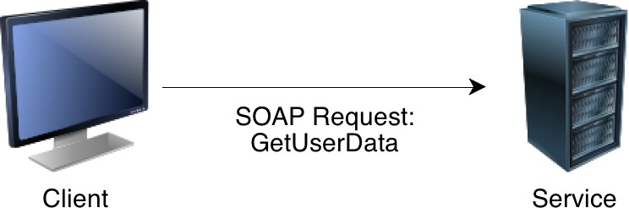
Example of WSDL & SOAP
Deﬁnition of an operation: GetUserData
The operation has an input and an output The input is deﬁned via GetUserDataRequest
The output is deﬁned via GetUserDataResponse

Slide 70
SOAP
Message inside an envelope
Envelop has optional header (~address), and mandatory body: actual container of data
SOAP message is unidirectional: it’s NOT a conversation
Notes:
© SE;Service orientation, Hans van Vliet
Soap is “zwaar”. Een lichtere variant is REST. Een RESTful web service is iets dat een simpele HTTP get request accepteert in plaats van een formeel SOAP request. Basic idea: every resource on the internet has a unique identifier, a URI. Als je REST ipv SOAP gebruikt, doe je gewoon een HTTP GET request voor zo’n URI.
Omdat communicatie asynchroon is iha, weet je dus niet zomaar welk antwoord bij welke vraag hoort. Daarom een begrip als correlatie; eigenlijk een soort factuurnr bij elk message, zodat je dat factuurnr kunt gebruiken m dingen bij elkaar te houden/plaatsen.

Slide 71
Example of SOAP
< soap:Envelope >
<soap:Body xmlns:m =" http: // www. example . org/ userdata ">
< m:GetUserData >
<m:email > user@example . org </ m:email >
</ m:GetUserData >
</ soap:Body >
</ soap:Envelope >

Slide 72
WSDL
Four parts:
  Web service interfaces
  Message definitions
  Bindings: transport, format details
  Services: endpoints for accessing service. Endpoint = (binding, network address)

Slide 73
Example of WSDL
<wsdl >
< wsdl:operation name =" GetUserData ">
< wsdl:input message =" es:GetUserDataRequest "/>
< wsdl:output message =" es:GetUserDataResponse "/>
</ wsdl:operation >
< xsd:element name =" GetUserDataRequest ">
< xsd:complexType >
< xsd:sequence >
< xsd:element name =" username " type=" string "/>
< xsd:element name =" role " type=" string "/>
</ xsd:sequence >
</ xsd:complexType >
</ xsd:element >
< xsd:element name =" GetUserDataResponse ">
< xsd:complexType >
<xsd:all >
< xsd:element name =" email " type =" string "/>
</ xsd:all >
</ xsd:complexType >
</ xsd:element >
<wsdl >

Slide 74
Orchestration of Services
How are services interconnected with each other?
Applications are realized by a combination of services
Orchestration takes care which services interact and when Control ﬂow can be automated via workﬂow engines Should help reuse by loose coupling and ﬂexibility

Slide 75
Binding of Services
Development-time binding vs. runtime binding
Development-time binding is far simpler
The services, their API and address are ﬁxed during development time
Runtime binding is more complex
The exact services and addresses are found during runtime Lookup by service name often the best approach

Slide 76
Discovery of Services
How do I ﬁnd the service for my needs?
UDDI aimed at a lookup service for businesses, organisation and services
UDDI as yellow pages for web services
No widespread use
Should help addressability

Slide 77
UDDI
Three (main) parts:
  Info about organization that publishes the services
  Descriptive info about each service
  Technical info to link services to implementation

Slide 78
UDDI (cnt’d)
Original dream: one global registry
Reality: many registries, with different levels of visibility
  Mapping problems

Slide 79
Service Types
Typical service (component) types in SOA systems:
Application frontend - typically not a service, initiate operation and receive results
Basic services - they build the foundation
Intermediary services - adapters and facades to add functionality, typically stateless
Process centric services - implement the business logic, typically manage the process state
Public services - for integration, higher level functionality

Slide 80
SOA and Software Architecture
SOA aims to decouple the system from the software architecture No alignment between the system layers and the service layers
system layers: browser, application server, web server, operation system
service layers: application, process, intermediary, basic

Slide 81
Example: Simple SOA Architecture
In the most simple case the SOA architecture consists of two layers
  The application layer, which uses the basic services
  The layer for the basic services
  For example: A web site of an airline

Slide 82
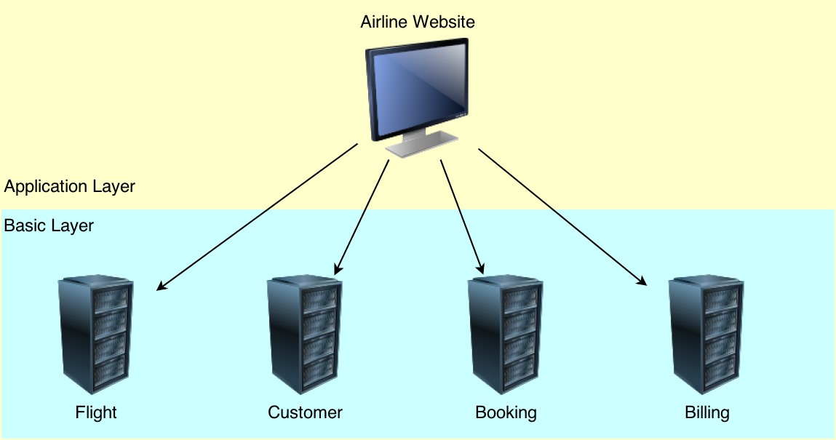
Example: Simple SOA Architecture

Slide 83
Facade Pattern
Intermediary services often serve as facade for basic services
They aggregate the functionality
Example for a n-tier architecture

Slide 84
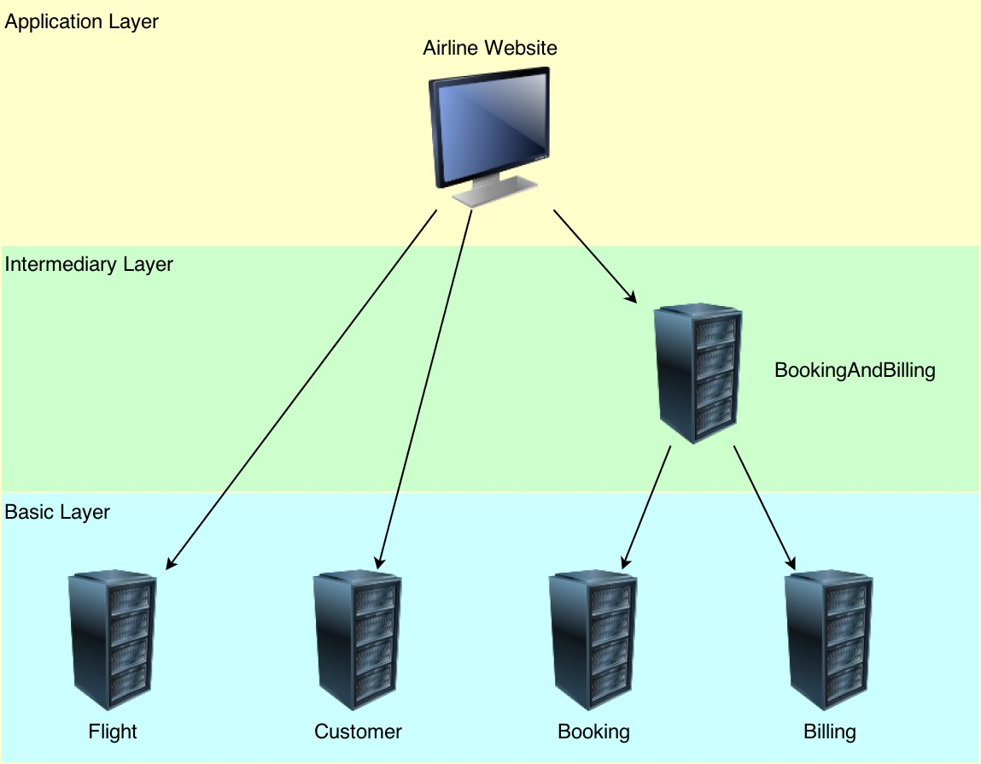
Example: Facade Pattern

Slide 85
Process-centric Services
Optional component in SOA systems
Process-centric services encapsulate process logic and application state
An application frontend may delegate the process control to such a component
Advantage: reuse when the process-centric services is shared by multiple clients
Disadvantage: more complex system, process control might be split into multiple components

Slide 86
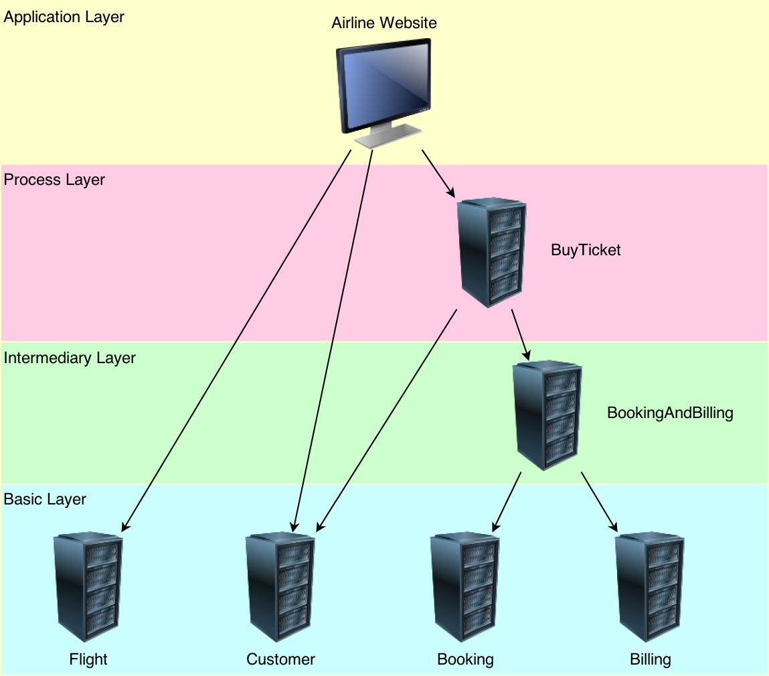
Example: Process-centric Services

Slide 87
BPEL4WS
Three main parts:
  Partnerlinks: dependencies between services: who sends what to whom
  Global variables
  Workflow model: “program”
BPEL4WS is an orchestration language; executable
WS-CDL (Web Services Choreography Description Language) is a choreography language; not executable

Slide 88
Service-Oriented Software Engineering (SOSE) life cycle
Service oriented
analysis
Service
development
Service
deployment
Service oriented
design
Service
testing
Service
administration
Notes:
© SE;Service orientation, Hans van Vliet
(p. 359)
- introduction
1) analysis: (ch 11+12) defines the potential scope of our SOA (service layers; service candidates)
2) design: (ch 13-16) how to build our SOA (standards-driven as industry conventions+SO principles; attention to the orchestration layer, which results in a formalized business process definition
3) development: construction; programming languages+development environments (.NET and J2EE); physical form of services (like web services) and of orchestrated business processes.
4) testing: (not covered, p.360) aimed at reuse and integrability, testing must be rigorous before deployment. Standard testing techniques may apply.
5) deployment: (p.360) installation and configuration of distributed components, service interfaces, middleware. Specific to the technology platform chosen.
6) administration: (p.361) application management issues similar to distributed, component-based applications. Examples concern: monitoring, version control for service description; performance bottlenecks.
- SO versus SERVICE: it is during analysis and design that SOA characteristics and SO principles are incorporated into the solution. This makes them specific for SOA development. The “service” phases aim at delivering services implementing the results from previous efforts.
- in general, though, each phase requires adaptation as compared with traditional SE. For instance, construction requires specific SOA technology; testing must take into consideration composition with services which are dynamically invoked; etc.

Slide 89
Terminology
service oriented environment (or service oriented ecosystem)
business process + supporting services
  application (infrastructure) service
  business service
    Task-centric business service
    Entity-centric business service
  hybrid service
Notes:
© SE;Service orientation, Hans van Vliet

Slide 90
Terminology
entity centric
hybrid services
order
fulfilment
service
entity-centric
hybrid services
task centric
task-centric
business services
purchase
order
service
customer
profile
service
verify
PO
service
business services
infrastructure services
wrapper
service
send
utility
service
notification
service
infrastructure services
Notes:
© SE;Service orientation, Hans van Vliet

Slide 91
Strategies for life cycle organization
Top-down strategy
Bottom-up strategy
Agile strategy
Notes:
© SE;Service orientation, Hans van Vliet
the simple phases described before need to be organized into a process that delivers a SOA, on a number of layers, and supports the transition towards a standardized SOA. The latest is the greatest challenge.

Slide 92
Top-down strategy
Service oriented
analysis
Service
development
Service
deployment
Service oriented
design
Service
testing
Notes:
© SE;Service orientation, Hans van Vliet
(p. 359)
- introduction
1) analysis: (ch 11+12) defines the potential scope of our SOA (service layers; service candidates)
2) design: (ch 13-16) how to build our SOA (standards-driven as industry conventions+SO principles; attention to the orchestration layer, which results in a formalized business process definition
3) development: construction; programming languages+development environments (.NET and J2EE); physical form of services (like web services) and of orchestrated business processes.
4) testing: (not covered, p.360) aimed at reuse and integrability, testing must be rigorous before deployment. Standard testing techniques may apply.
5) deployment: (p.360) installation and configuration of distributed components, service interfaces, middleware. Specific to the technology platform chosen.
6) administration: (p.361) application management issues similar to distributed, component-based applications. Examples concern: monitoring, version control for service description; performance bottlenecks.
- SO versus SERVICE: it is during analysis and design that SOA characteristics and SO principles are incorporated into the solution. This makes them specific for SOA development. The “service” phases aim at delivering services implementing the results from previous efforts.
- in general, though, each phase requires adaptation as compared with traditional SE. For instance, construction requires specific SOA technology; testing must take into consideration composition with services which are dynamically invoked; etc.

Slide 93
Top-down SO analysis
step 1
step 2
step 1
step 2
Define enterprise
business models
Compose SOA
Service oriented
design
step 3
step 4
step 3
step 4
Define enterprise
service model
Perform service
oriented analysis
....
Notes:
© SE;Service orientation, Hans van Vliet
(p. 364)
Specifically, analysis is preceded by business modeling based on the company's existing business logic. This strategy promotes the creation (or re-alignment) of the organization's overall business models.
With this strategy we can develop all service layers.
1) depends very much on company specific BM approaches; re-defines the enterprise information architecture; entity models resulting in entity-driven services. Typical entities can be: customer profile; purchase order; insurance policy.
2) selection of the technology (data representation like XML; industry standards; platform like Web services.
3) defines the enterprise-wide service portfolio; inventory of all potential services.
4) analysis as described before defining service operations and services.
Iteration for refinement is mainly between phases 3 and 4.
- pros: high quality; reusability; standardized enterprise.
- cons: time and money (considerable up-front analysis work)

Slide 94
Bottom-up strategy
Model application
services
Develop
application
services
Deploy
services
Design application
service
Test
services
application service = infrastructure service
Notes:
© SE;Service orientation, Hans van Vliet
(p. 366)
This strategy aims at creating “application-centric requirements”. Service are built ad needed. Primary motivation is integrations, where legacy is encapsulated in wrappers.
Hence:
- Development concerns “application services” instead of “services”. With this strategy we develop only application service layers as hybrid + utility services.
- no analysis but modeling
- no administration
The majority of companies nowadays building Web services apply this strategy.
- pros: fast extension of current portfolio with new web services
- cons: older applications remain unchanged, as well as the existing architecture (hence SO principles are rarely considered); low reusability, often requiring a complete re-engineering of the whole system, demanding high investments.

Slide 95
Agile strategy
Top-down
analysis
SO analysis
align with
current state
business
models
SO design
Develop services
Test service operations
Deploy services
Revisit business
(and process) services
align with
current state
business
models
on-going
Notes:
© SE;Service orientation, Hans van Vliet
(p. 370)
Similar to RAD (prioritize requirements and develop incrementally).
Includes a first and orthogonal step covering the first three steps of the top-down strategy but focussed on areas of the enterprise that have priority and need immediate attention.
step 2) concerns analysis for the business model fragment with priority.
- pros: enforce the concept of immutable service contracts; more effort (for alignment) but distributed over services.
- cons: (hence) demands version control for e.g. published service descriptions; needs maintenance (to ensure that existing services are kept in alignment with revised business model);

Slide 96
Service oriented analysis
The process of determining how business automation requirements can be represented through service orientation
Notes:
© SE;Service orientation, Hans van Vliet
How to translate business processes in a service portfolio implementing SO principles
(re-)shape the organization of automation logic
prepare for SO design
use service models and SO principles to define a preliminary service environment

Slide 97
Goals of SO analysis
  Service operation
  candidates
  Service candidates
  (logical contexts)
Appropriateness for intended use
Identify preliminary issues that may challenge required service autonomy
Define known preliminary composition models
Notes:
© SE;Service orientation, Hans van Vliet
1) Define preliminary set of service operation candidates
2) Group operations into logical contexts (service candidates)
3) Define service boundaries (encapsulated logic)
4) Assess appropriateness for intended use
5) Identify preliminary issues that may challenge required service autonomy
6) Define known preliminary composition models

Slide 98
3 Analysis sub-steps
step 1
Service oriented
analysis
Define
analysis scope
step 2
Identify
automation
systems
Service oriented
design
step 3
Model
candidate services
...
Notes:
© SE;Service orientation, Hans van Vliet

Slide 99
Step 1: Define analysis scope
  Mature and understood business requirements
    S = ∑i Si, where smaller services may still be quite complex
  Can lead to
    process-agnostic services/service operations (generic service portfolio)
    services delivering business-specific tasks
  Models: UML use case or activity diagrams
Notes:
© SE;Service orientation, Hans van Vliet

Slide 100
Order Fulfillment Process
start
receive PO
Transform
PO
validate PO
Import
PO
PO
valid
yes
Send PO
to queue
no
Send
notification
stop
Notes:
© SE;Service orientation, Hans van Vliet

Slide 101
Step 2: Identify automation systems
What is already implemented?
  encapsulate
  replace
Models: UML deployment diagram, mapping tables
Notes:
© SE;Service orientation, Hans van Vliet

Slide 102
Order Fulfillment Process
already
automated
by
Order
fulfillment
service
start
(XML -> native format)
(currently custom
component)
service candidate
receive PO
Transform
PO
same as
previous
validate PO
(into accounting sys.)
service candidate
(currently custom legacy)
service candidate
Import
PO
PO
valid
yes
same as
previous
Send PO
to queue
(to accounting clerk's
work queue)
same as previous
no
Send
notification
stop
Notes:
© SE;Service orientation, Hans van Vliet

Slide 103
Step 3: Model candidate services
How to compose services?
Service (candidates) conceptual model
  operations + service contexts
  SO principles
Focus on task- and entity-centred services
Models: BPM, UML use case or class diag.
Notes:
© SE;Service orientation, Hans van Vliet

Slide 104
Example service operation candidates
Receive PO document
<<include>>
Validate PO document
PO processing
service
...
(If PO document is invalid,)
send rejection notification
(and end process)
<<include>>
Transform PO document
into native
electronic PO format
Notes:
© SE;Service orientation, Hans van Vliet

Slide 105
Example business process logic
Not service operation candidates
  if PO document is valid, proceed with the transform PO document step
  if the PO document is invalid, end process
Notes:
© SE;Service orientation, Hans van Vliet

Slide 106
Task- versus entity-centred services
Task-centred
  (+) direct mapping of business requirements
  (-) dependent on specific process
Entity-centred
  (+) agility
  (-) upfront analysis
  (-) dependent on controllers
Notes:
© SE;Service orientation, Hans van Vliet

Slide 107
Benefits of business-centric SOA
introduce agility
prepare for orchestration
enable reuse
Notes:
© SE;Service orientation, Hans van Vliet

Slide 108
Modeling
identify agnostic service candidates
filter out process-specific logic
apply SO principles
identify candidate service compositions
identify application service operation/service candidates
apply SO principles
revise operation candidates grouping
step 1
Define
analysis scope
step 2
Identify
automation
systems
step 3
Model
candidate services
Notes:
© SE;Service orientation, Hans van Vliet
The result is basically a set of business service compositions
+ generic and infrastructure services

Slide 109
Entity Models
Invoice
*
1
PO
*
1
1
*
1
*
1
1
Employee
Order
*
1
*
1
Customer
1
Notes:
© SE;Service orientation, Hans van Vliet

Slide 110
Service modeling guidelines
task-centric business service candidates
  reusability of encapsulated logic across processes
Notes:
© SE;Service orientation, Hans van Vliet

Slide 111
Service modeling guidelines
task-centric business service candidates
  reusability of encapsulated logic within a process
...
Notes:
© SE;Service orientation, Hans van Vliet

Slide 112
Service modeling guidelines
identify logical units of work with explicit boundaries
  SO principle about autonomous services (hiding logic)
...
Notes:
© SE;Service orientation, Hans van Vliet

Slide 113
Service-oriented design: design sub-steps
Service oriented
analysis
step 1
Compose SOA
Service oriented
design
step 2
Design entity-centric
business services
step 3
Design infrastructure services
...
step 4
Design task-centric
business services
step 5
Design SO
business process
Notes:
© SE;Service orientation, Hans van Vliet

Slide 114
Entity-centric business services
    Goal: entity-centric business service layer + parent orchestration layer
Invoice
1
PO
Receive PO document
*
*
...
<<include>>
Customer
Hours billed
*
Validate PO document
1
*
PO processing
service
1
*
...
Order
1
1
Employee
(If PO document is invalid,)
send rejection notification
(and end process)
*
Email
Weekly hours
...
<<include>>
1
Transform PO document
into native
electronic PO format
*
Customer
1
1
...
Notes:
© SE;Service orientation, Hans van Vliet

Slide 115
Infrastructure services
PO
processing
service
Orchestration/coordination layer
Verify
PO
service
PO
service
Business service layer
Notification
service
Transform
service
Infrastructure service layer
Notes:
© SE;Service orientation, Hans van Vliet

Slide 116
Task-centric business services
UML sequence diagram
  express and refine order of invocations implicit in the UML use case diagram
Receive PO document
Verify PO
service
PO
service
Notification
service
<<include>>
Validate PO document
get_PO
PO processing
service
[PO data]
...
(If PO document is invalid,)
send rejection notification
(and end process)
verify
<<include>>
Transform PO document
into native
electronic PO format
send_reject
Notes:
© SE;Service orientation, Hans van Vliet

Slide 117
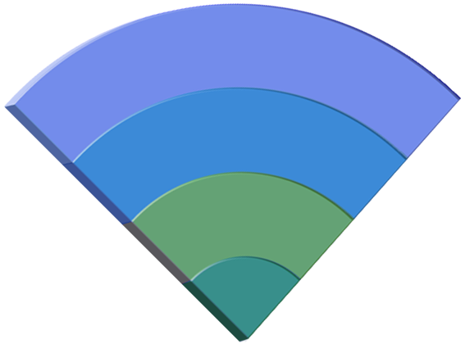

Getting To SOA
Optimize
Business Domain
IT Domain
On Demand Transformation
Automate
On Demand Transformation
Effectiveness
Composite
Applications
Integrate
Efficiency
Interactions
Connect
Tasks
Connections
Notes:
Adoption model -- Levels of adoption:
Connect: Assure reliable and flexible information flow between diverse applications & systems
Integrate: An integration framework that supports interoperability among heterogeneous environment – removing barriers to building an integrated architecture powered by web services and non-web services applications and integration approaches
Automate: The orchestration of business and IT processes to align IT with the business goals to grow revenue while containing costs.
Optimize: A holistic approach to transform and manage a business by aligning strategic and operational objectives with business activities and supporting IT services

Slide 118
Moving to Services-Oriented Solutions
Business Process Layer
Cross Functional End-to-end Sales Order Process
Service Layer
How do you connect sales to customers?
Product
Sales
Customer
Employee
Finance
SAP
Application Layer
Applications, Components, Software
How do you connect SAP to Siebel?
Outlook
Siebel
People
Soft
Dir
Linux
MQ
.NET
OS/390
Technology Layer
Hardware, Network
How do you connect J2EE to .NET?
J2EE
Unix
DB2
Source: CBDi Forum, http://www.cbdiforum.com

Slide 119
SOA in Practice
Business Process
Not In Stock
Stock Out
Action (Staff Activity)
Order
Request
may be long running
multiple valid process states
alternative workflows for non-normal conds and/or compensation for exception management
Check
Inventory
ATP/Delivery
In Stock
Allocate Stock
Business Transaction
Validate Request
Process Action
Validate
Product Request
short term, non-interactive
one change of business state or STP
consumes one or more function service
targeted level of service reuse
loose coupling very important
may require compensating transactions
Valid
Invalid
Process Action
Function Service
Authorization Service
Order Service
collaborations to implement a single FS
collaborating apps encapsulated via FS(s)
Billing Service
Product Service
Customer
Records
Product
Information
Inventory
Mgmt
Order
System
Billing System

Slide 120
SOA Solution Abstraction Layering
. . . Leveraging the SOA Reference Architecture
Channel
B2B
B2C
Consumers
Service Consumer
Business Process
Composition; choreography;
business state machines
Services
Atomic and Composite
Data Architecture (meta-data) &
Business Intelligence
QoS Layer (Security, Management &
Monitoring Infrastructure Services)
Integration (Enterprise Service Bus)
Governance
Service Components
Service Provider
Operational Systems
Packaged
Application
Custom
Application
OO
Application
Atomic Service
Composite Service
Registry

Slide 121





Loose Coupling is enabled by an “ESB”
Turn this…
…into this.
Service
Service
Service
Service
Service
Service
Service
Service
Interface
Interface
Interface
Interface
Interface
Interface
Enterprise Service Bus
Interface
Interface
Interface
Interface
Interface
Interface
Interface
Interface
Service
Service
Service
Service
Service
Service
Service
Service
Decouples the point-to-point connections from the interfaces
Allows for dynamic selection, substitution, and matching
Enables more flexible coupling and decoupling of the applications
Enables you to find both the applications and the interfaces for re-use
RESULT → Greater Business Responsiveness
Notes:
Next few charts will talk about ESB.. ..
ESB is key enabler for loose coupling…
1) It virtualizes the interface, or in other words, it decouples the point-to-point connections from the interfaces themselves.
2) The interfaces are put into a third party broker which helps you manage the interfaces better.
3) The enables faster and more flexible coupling and decoupling of applications.
4) Because you can find all of the applications and the interfaces, you can then reuse both.

Slide 122
Section
SaaS
Software as a Service

Slide 123
SaaS
SaaS Idea
An application is made available via a service interface. The application is hosted by a service provider via the internet (commonly referred to as the Cloud).
If the service is hosted within an organisation (instead of the cloud), it is called “on premises software”.

Slide 124
SaaS
Properties of SaaS
Advantages: One has not worry about application deployment, maintainance, security
Disadvantages: Loose control over the application, the service provider may conduct unwanted changes
The billing is often done on per request basis and low entry prices Examples: Salesforce.com, Sensium.io

